Slide 1
Factor Analysis w/ R
Lead: Aishat Sadiq
Support: Jacob Grippen
F23 CCSS DSF
Notes:
Slide 1 - AS + JG Intro
3rd year Psychology PhD student in the School of Human Ecology under the advisement of Will Hobbs (specializes in NLP + quantitative modeling)
Past: Neuroscience, African & African-American Studies, French,
Now: Health and Development, Psychology, Data Science*
Democratizing Data, making it more accessible for everyone to use
Currently my time is split between two projects:
Large grant funded qualitative study to build a systems dynamic model of structural racism in the US food system and its relationship to childhood obesity. Includes a traditional systematic-scoping literature review and a novel rapid review methodology using documentaries. I’m leading the Delphi study - an iterative, consensus building process with field experts collaboratively build a preliminary model to take to the convening next semester for finalization.
Linking 11 secondary datasets, I am measuring the association between cognitive functioning and scarcity of social, financial, and temporal resources.
Jacob Intro

Slide 2
Learning Aims/outline
Understand the concept of factor analysis and its applications.
Understand the difference between exploratory factor analysis, principal components analysis, and confirmatory factor analysis
Learn how to perform factor analysis in R
EFA
CFA
Visualization
Notes:
Slide 2 - Learning Aims & Outline
Go over some vocab to make sure we’re all on the same page
Factor analysis is a collection of statistical methods used to describe variability in observed, correlated variables using a smaller number of unobserved variables called factors (or latent variables).
Idea: Large number of observed variables (measured variables, manifest variables, indicators) reflect a smaller number of underlying latent variables that cannot be directly observed.
Spending the most time on getting hands dirty!

Slide 3
Food Insecurity Manuscript Example
Notes:
Slide 3 - Food Insecurity Manuscript Example
Rstudio Live Demo
Install and load libraries
Lavaan, Sem, Psych
Import DFs
Discuss CFA and EFA dfs later (the same…oops)
Descriptive Library, Full Set -> cannot share this data bc it contains sensitive & protected data
Risk Tolerance CFA
Run code to show plot, but discuss no details

Slide 4
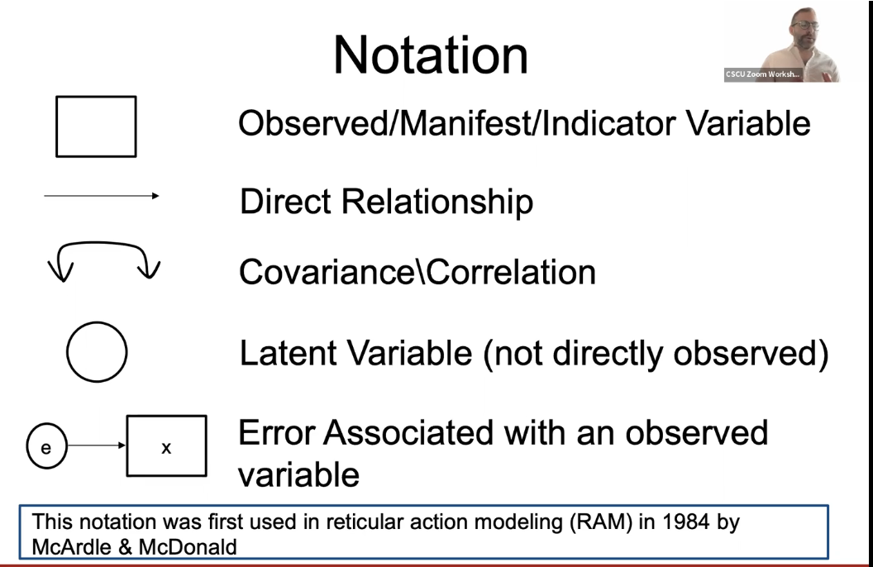
Notes:
Slide 4 - Notation
SEM code format; Lines 35:53
Observed = reward_sensitivity + BAS_score + BART_adj_total_pumps + Demographics_ParentalIncome + Demographics_MotherEdu + Demographics_FatherEdu + Demographics_Race + FIS_food_insecurity_score + Radimer_home_food_insecure + Radimer_cornell_food_insecure
Latent = Risk_Taking, SES, FI

Slide 5
Vocabulary
Factor, Latent Variable
Factor Rotation: Orthogonal, Oblique, & others
Eigenvalues + Eigenfactors
Observed Variable, Items, Indicators
Exploratory Factor Analysis
Dimension Reduction, Principal Component Analysis
Confirmatory Factor Analysis (CFA)
Structural Equation Modeling (SEM)
Notes:
Slide 5 - Vocabulary
Are there any words on this list that you would like me to explain?
Eigenvalues provide a measure of importance of a factor (amount of common variance explained by a factor).
Observed variables - measured variables, manifest variables, indicators
Factors - broad concepts or ideas that may describe an observed phenomenon.
PCA attempts to explain the maximum amount of total variance in R using the fewest components possible. EFA does the same but focusing on common variance. The unique variance is ignored.

Slide 6
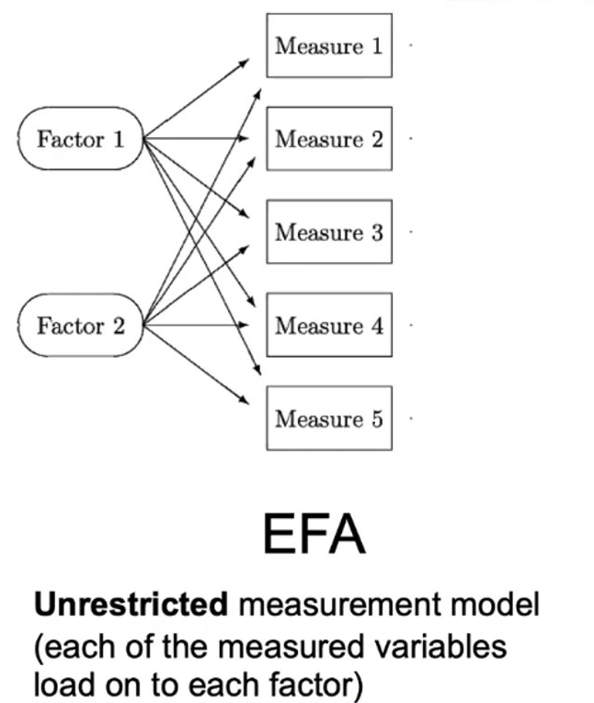
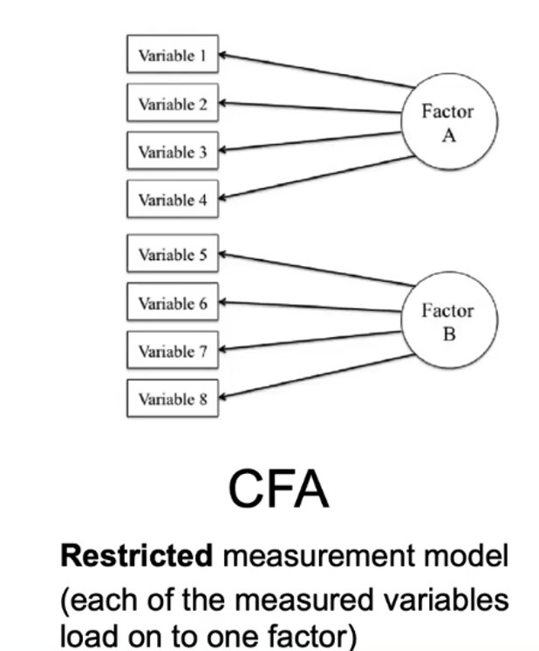
Types of Factor Analysis
EFA
CFA + SEM
Notes:
Slide 6 - Types of FA: CFA & EFA
Two types of factor analysis: Exploratory and Confirmatory
Exploratory Factor Analysis - Used to explore underlying structure of a dataset when a researcher does not have any specific a priori hypotheses about the number or structure of the latent variables.
Objective is to determine the number of factors influencing a set of measured variables and assess the strength of the relationship between each factor and each observed variable.
Each observed variable is a linear function of the unobserved factors.
Confirmatory Factor Analysis - Used when a researcher has specific hypotheses about the number of factors and which observed variables are related to which factors. Primary objective of a CFA is to determine the ability of a predefined, hypothesized model is consistent with data

Slide 7
Lavaan SEM Syntax
Before running our first factor analysis, here's the most frequently used syntax in lavaan:
~ predict, used for regression of observed outcome to observed predictors
=~ indicator, used for latent variable to observed indicator in factor analysis measurement models
~~ covariance
~1 intercept or mean (e.g., q01 ~ 1 estimates the mean of variable q01)
1* fixes parameter or loading to one
NA* frees parameter or loading (useful to override default marker method)
a* labels the parameter ‘a’, used for model constraints
Notes:
Brief overview

Slide 8
Modeling Assumptions + Rules of Thumb
Large Data
N > 300
10-15 observations (N) per variable
Low collinearity = greater sample size req
Notes:
Sample Size - Kaiser-Meyer-Olkin measure of sampling adequacy (KMO) can be calculated for individual or groups of variables.
• Measure of the proportion of variance that might be
common variance.
• Calculated from correlation matrix
• Should have KM0 > 0.5; ideally, KMO > 0.8
• Consider excluding variables with low KMO values.
Correlation
• Ideally, observed variables will be correlated, but not
too correlated!
• Variables not correlated means that there may not be
underlying latent variables that can explain observed
data.
• Variables too correlated means that it will be difficult to
determine the unique contribution of factors to each of
the correlated variables.
• Rule of thumb: Exclude variables with “lots” of
correlations < 0.3 or > 0.8.

Slide 9
Live Coding Demo
Notes:
Scree plot of eigenvalues: look for “elbow” and select the number of factors before the elbow
Factor Extraction
• Several methods exist for extracting factors from data.
• R has p eigenvalues, one corresponding to each possible factor: the larger the eigenvalue, the more important the factor.
Factor Rotation
• Orthogonal rotations: Varimax*, Quartimax, Equamax
• Oblique rotations: Oblimin*, Promax
• Bigger questions: Orthogonal vs Oblique?
• Is it reasonable to assume the factors are independent?
• Yes – use an orthogonal rotation
• No – use an oblique rotations
• Some would argue that it’s almost never reasonable to
assume independence.
Measures of absolute fit:
• RMSR – root mean square of the residuals
RMSR < 0.05
• RMSEA (RMSA) – root mean square error of approximation
RMSEA < 0.08
• SRMR – standardized root mean square residual
SRMR < 0.08
Measure of fit versus a baseline model:
• TLI – Tucker-Lewis index (fit model vs null), TLI > 0.95
• CFI – comparative fit index (fit model vs null, sample size
adjusted), CFI > 0.90
Information theoretic indices:
• AIC, BIC
Goodness-of-fit tests and fit indices are rotation invariant.
Reliability - Cronbach’s alpha can be used to measure internal consistency of the variables loading onto a factor.

Slide 10
Steps
Fit a CFA model using the lavaan package
One factor
Two factors
All factors
Fit a EFA model using the psych package
Determine number of factors
Extract (and rotate) factors
Score and run model
Measure model fit
Notes:
Conclusion
• Performing a factor analysis can require a lot of
decisions and judgement calls.
• Important to have a strong theoretical basis
especially for confirmatory factor analysis.
• Confirmatory factor analysis is an important part of
structure equation modeling.
• Structural Equation Modeling (SEM) combines CFA
and regression.

Slide 11
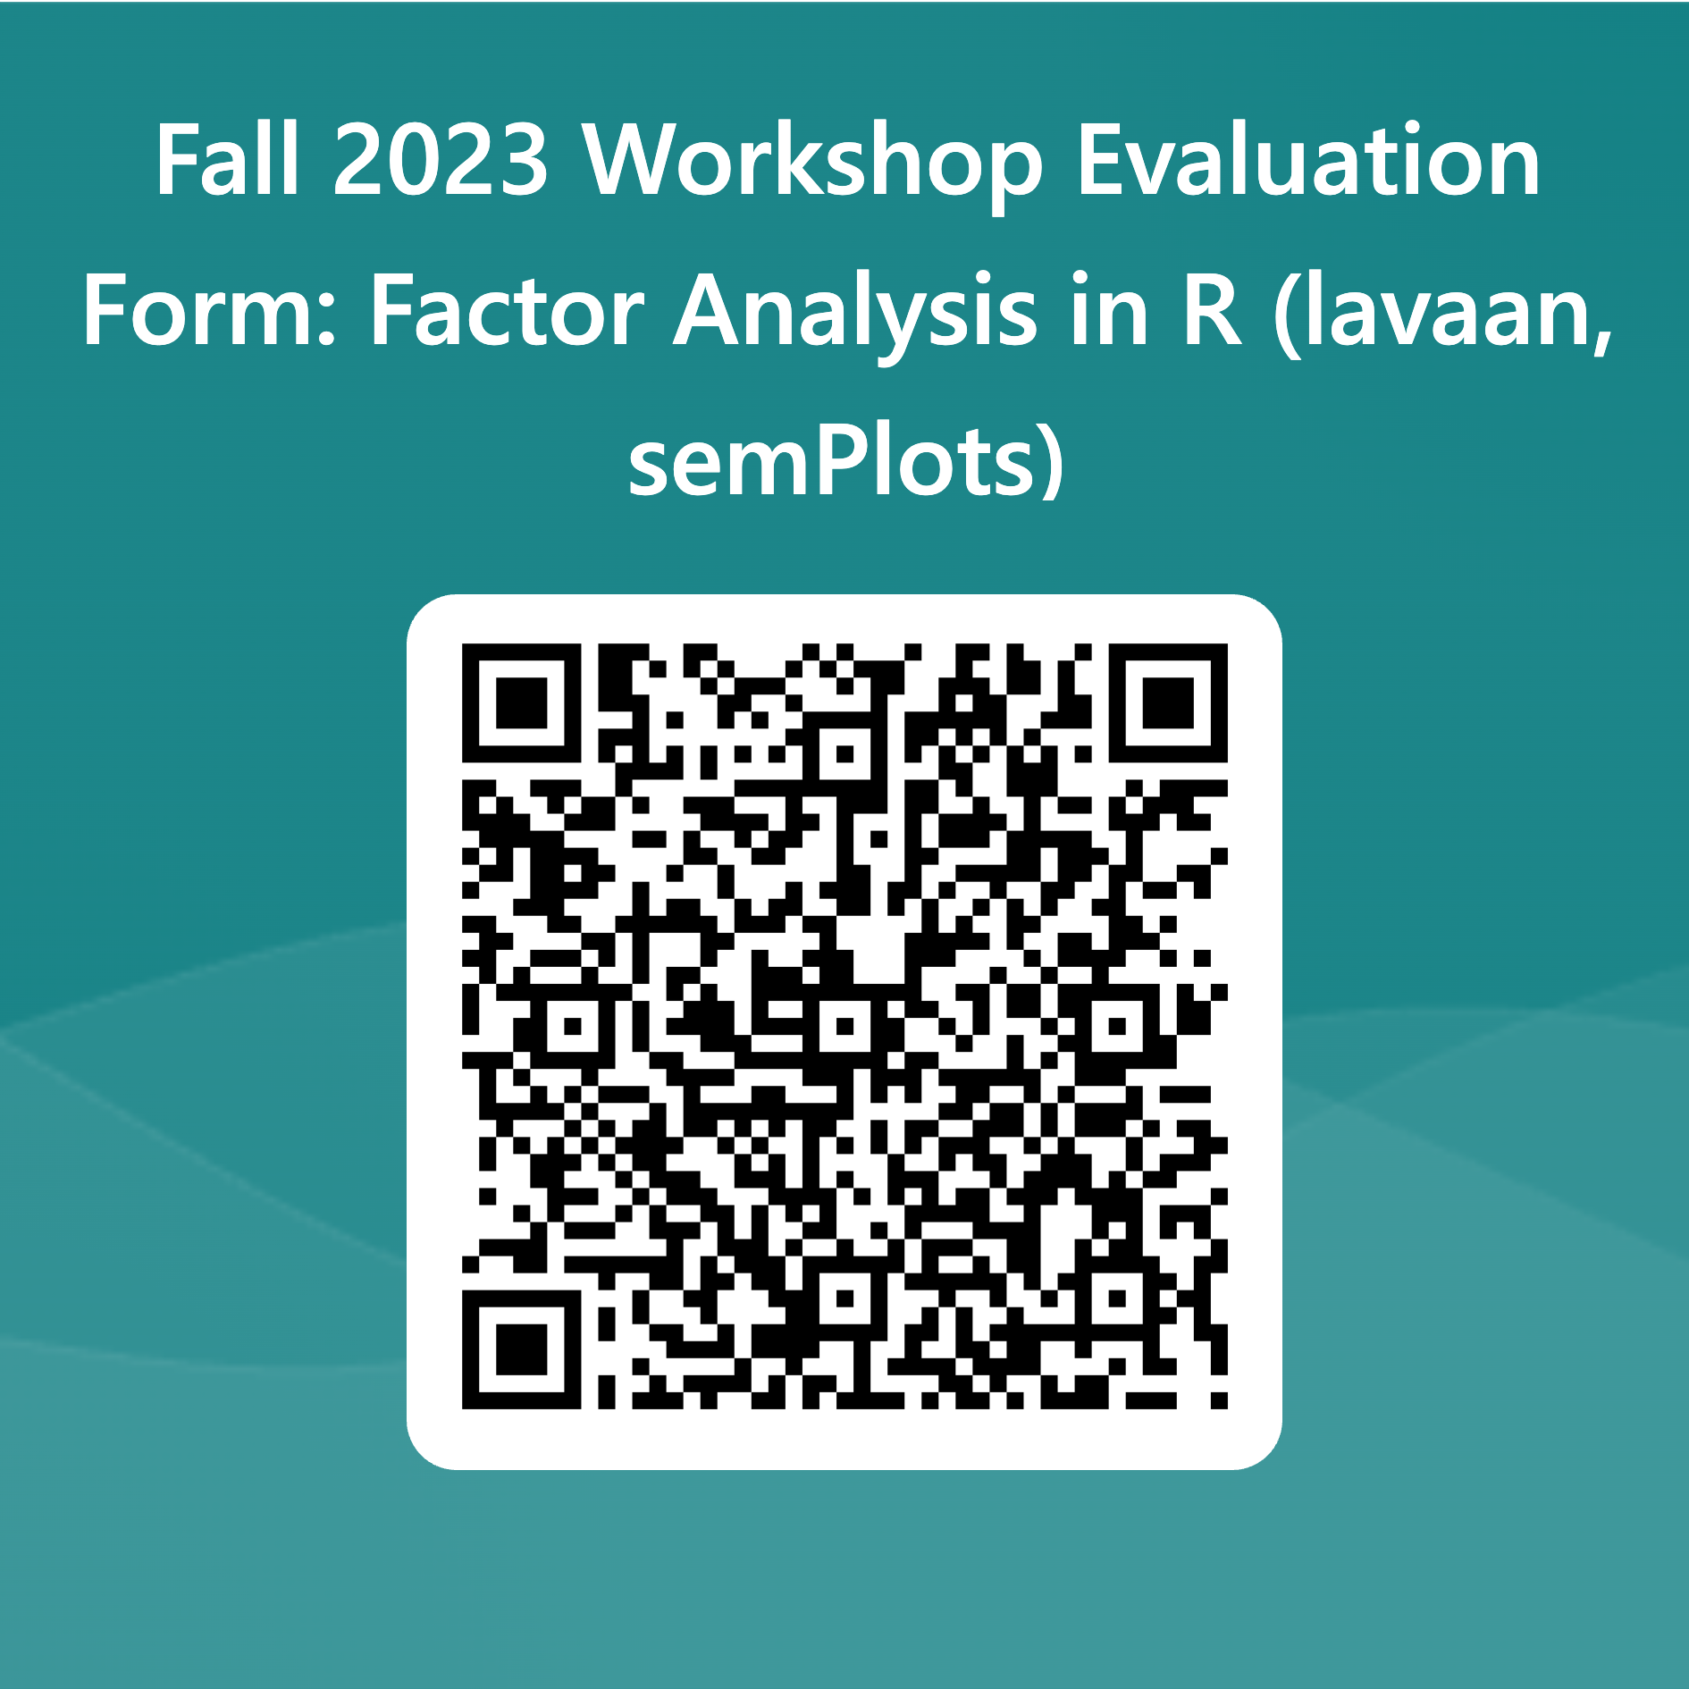
Notes:
https://forms.office.com/Pages/ResponsePage.aspx?id=ZkN-XZsbz0WOebFLJ99G4SUXqdLlghJDhzZ5bd0gLPtUQUVYVVg1TjkzU0pQWFU4WTYxQVBKQkYxTi4u

Slide 12
Q&A

Slide 13
JUNKYARD

Slide 14
Interpreting Results?

Slide 19
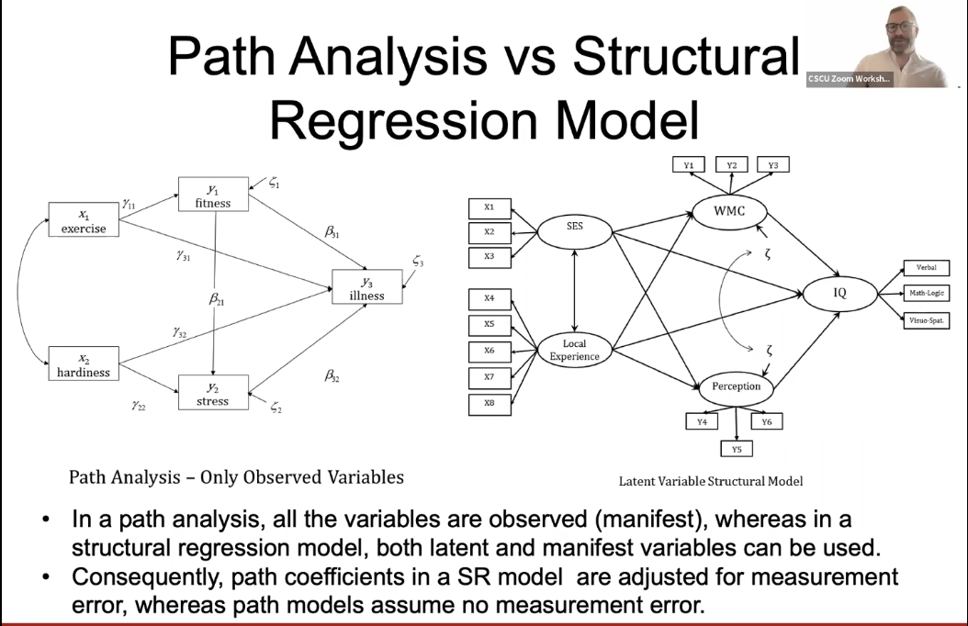

Slide 21
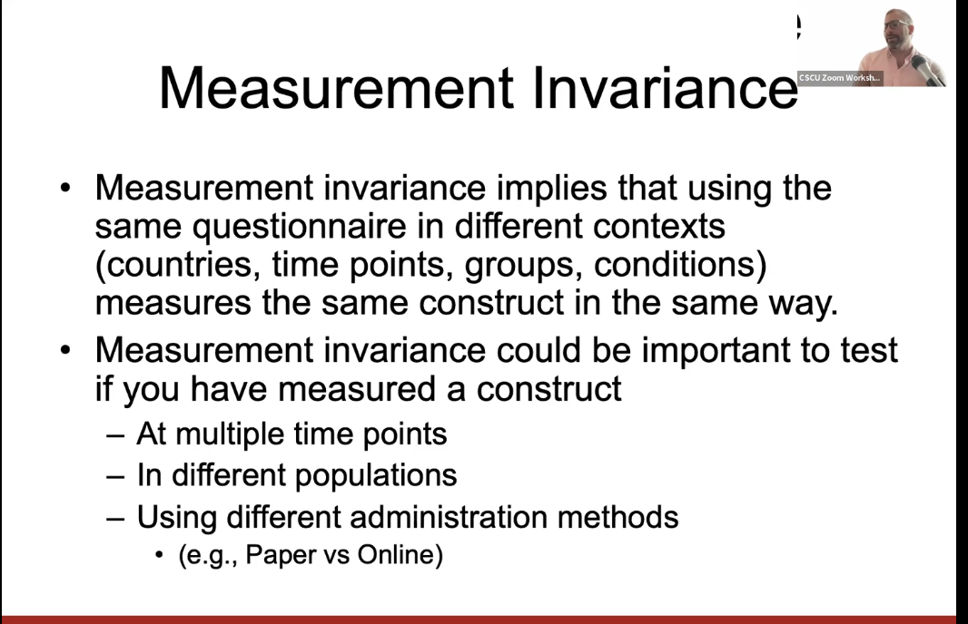
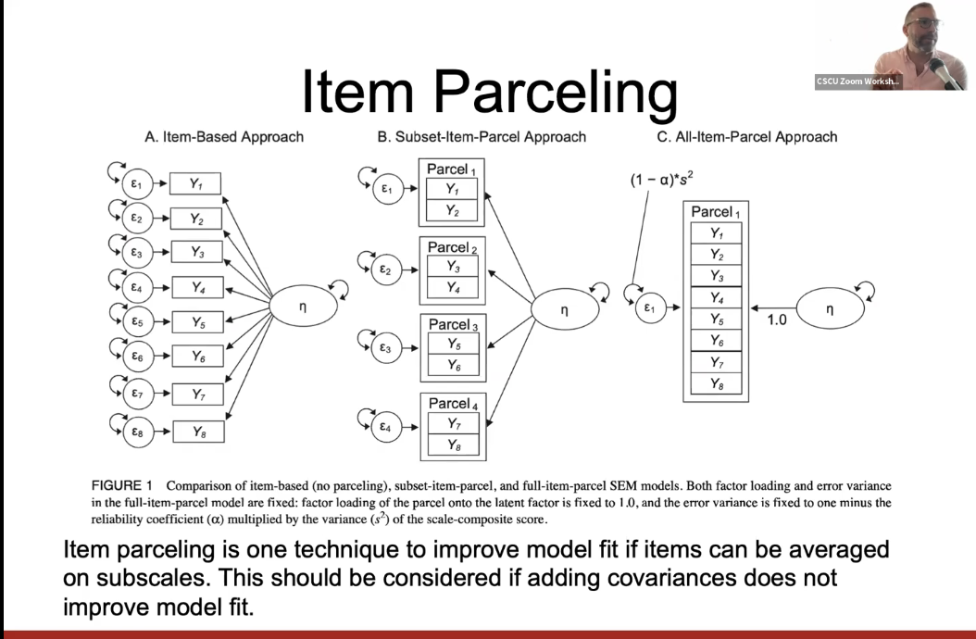
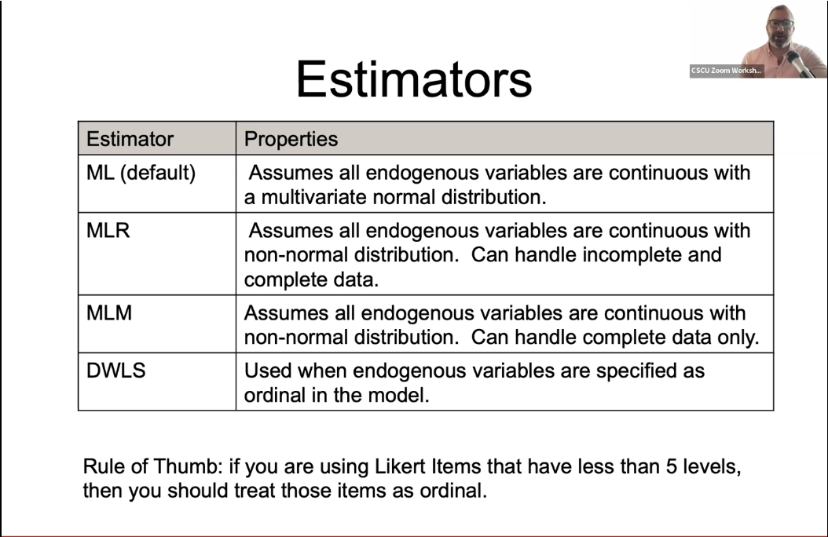
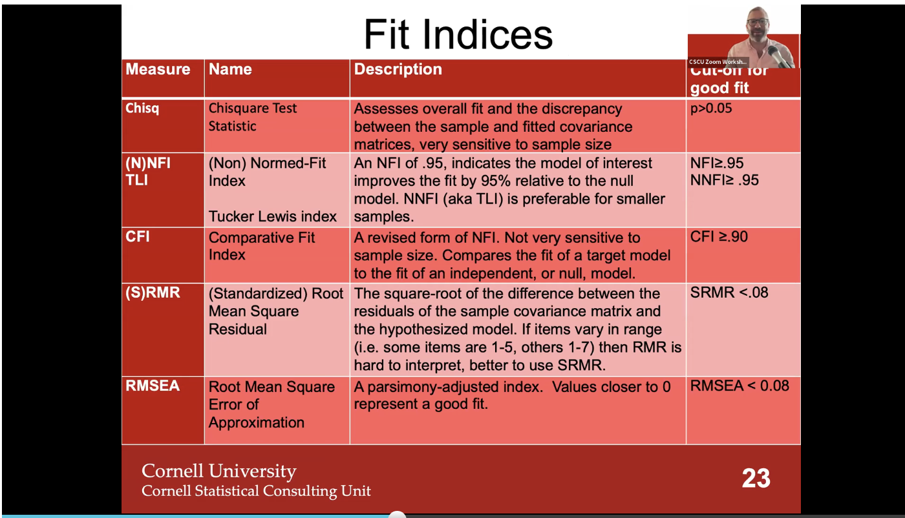

Slide 22
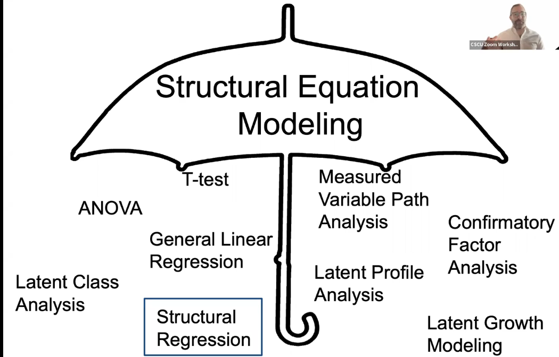
What is Factor Analysis (FA)? And what is is not FA?

Slide 23
Advantages & Disadvantages
Advantages
Disadvantages

Slide 24
Vocabulary
Factor/Latent Variable
Orthogonal/Factor Rotation
Eigenvalues + Eigenfactors
Observed Variable
Items/Indicators
EFA
Dimension Reduction/PCA
CFA/SEM
Loading
Covariate
Correlation
Common Variance vs Unique Variance
Communality/Co-linearity

Slide 25
Agenda
Vocabulary
Notation
Main Types
Advantages + Disadvantages
Modeling Assumptions
Package Overview
internal consistency (cronbach alpha), reliability, validity
identification, estimation, and model fit
measurement invariance
Live coding
Vizualize

Slide 26
Packages
base r - factanal() function
library(psych) :: fa() function
library(lavaan)
library(lavaanPlot)
library(semPlot)
library(sem)
library(semTools)
Notes:
=~ indicates that the latent factor on the left side is loaded on the observed indicator listed on the right side
specify the covariance between two variables (observed/latent) using ~~
In order to free a parameter, put NA* in front of the parameter to be freed, to fix a parameter to 1, put 1* in front of the parameter to be fixed. The syntax NA*q03 frees the loading of the first item because by default marker method fixes it to one, and f ~~ 1*f means to fix the variance of the factor to one.

